Slide 1
PHISHING DETECTION SYSTEM
CAPSTONE PROJECT
Presented By:
Agalya S
RMD Engineering College
Computer Science and Business Sytems

Slide 2
OUTLINE
Problem Statement
Proposed System/Solution
System Development Approach
Algorithm & Deployment
Result
Conclusion
Future Scope
References

Slide 3
Problem Statement
Have you ever wondered how cybercriminals craft phishing Links to deceive recipients? Or how to stay safe from increasingly sophisticated phishing attacks? Or how organizations can proactively detect and block these fraudulent attempts to safeguard sensitive information? What if you could predict whether an link was likely to be a phishing attempt based on its content and metadata? This Phishing detection System can help you explore those questions!
Phishing attacks are a pervasive threat to online security, with attackers employing sophisticated tactics to evade detection by traditional rule-based systems.
The increasing complexity of phishing attacks necessitates the development of more advanced detection methods capable of identifying novel and adaptive threats.
Existing phishing detection systems often rely on manual feature engineering, which can be time-consuming and prone to errors, leading to reduced accuracy and increased false positives.
The lack of robust and scalable phishing detection systems hinders the ability to effectively mitigate the risk of phishing attacks, resulting in significant financial losses and reputational damage.

Slide 4
Proposed Solution
To systematically address the problem of detecting phishing URLs using machine learning, the following approach outlines the key technical steps involved in detail:
Data Collection: Gather datasets from sources like Kaggle or PhishTank, ensuring they include relevant features such as URL length, HTTPS presence, and domain age to differentiate between phishing and legitimate URLs.
Data Preprocessing: Clean the data by removing duplicates and handling missing values, extract meaningful features from URLs, encode categorical variables, and normalize numerical features to prepare the data for modeling.
Machine Learning Algorithm: Evaluate and train multiple machine learning models like Gradient Boosting, CatBoost, and XGBoost, using techniques such as GridSearchCV for hyperparameter tuning to optimize their performance.

Slide 5
Proposed Solution
Deployment: Serialize the best-performing model using pickle or joblib, develop a Flask or FastAPI web application to serve the model, and create an API endpoint for URL classification.
Evaluation: Assess model performance using metrics like accuracy, f1_score, recall, and precision, perform k-fold cross-validation, and analyze feature importance to ensure robust and reliable predictions.
Result: Highlight the best-performing model's accuracy and key influential features, and ensure the deployed application can handle real-world data, providing users with a reliable tool for phishing URL detection.

Slide 6
System Approach
The system approach outlines the overall strategy and methodology for developing and implementing the phishing detection system:
System Requirements:
CPU: Multi-core processor
RAM: Minimum 8 GB (16 GB or more recommended)
Storage: SSD with at least 50 GB free space
Optional GPU for faster training with large datasets
Operating System: Windows, macOS, or Linux
Python 3.6 or higher
IDE: Jupyter Notebook, VS Code, or PyCharm
Web Server: Flask or Django for deployment
Version Control: Git

Slide 7
system approach
Libraries Required
Data Handling and Processing:
pandas, numpy
Data Visualization:
matplotlib, seaborn
Machine Learning and Model Building:
scikit-learn, xgboost, lightgbm, catboost
Natural Language Processing:
nltk, re (Regular Expressions for URL parsing)
Model Deployment:
Flask or Django, gunicorn (for WSGI server), requests (for testing API endpoints)

Slide 8
system approach
Data Collection:
Sources: Utilizes PhishTank, OpenPhish datasets, and performs web scraping. Integrates real-time cybersecurity feeds.
Attributes to Collect: Gathers URL text, domain age, reputation, WHOIS information, HTTPS presence, URL structure, and lexical features.
Data Preprocessing:
Data Cleaning: Removes duplicates, handles missing values for data integrity.
Feature Extraction: Extracts domain/subdomain info, URL components, computes statistical features, and tokenizes textual content.
Feature Engineering: Generates new features based on domain reputation scores and identifies phishing URL patterns.

Slide 9
system approach
Model Building:
Algorithm Selection: Chooses Gradient Boosting, XGBoost, LightGBM, and CatBoost for their classification performance.
Training the Model: Tunes hyperparameters, uses cross-validation for robustness.
Feature Importance Analysis: Identifies key features influencing predictions for model refinement.
Model Evaluation:
Metrics: Evaluates Accuracy, Precision, Recall, F1-Score, ROC-AUC Score for model performance.
Validation: Uses confusion matrices, ROC/precision-recall curves to validate and compare model effectiveness.

Slide 10
system approach
Deployment:
Model Serialization: Saves models using pickle or joblib for reuse.
API Development: Builds RESTful API (Flask or Django) for real-time URL classification.
Server Setup: Configures WSGI server (e.g., gunicorn), handles API requests, ensures scalability.
Testing and Monitoring: Tests API endpoints (e.g., Postman), implements logging, CI/CD pipelines for updates and maintenance.

Slide 11
Algorithm & Deployment
The system employs a range of machine learning algorithms, including:
Gradient Boosting Classifier: A popular ensemble learning algorithm that combines multiple weak models to create a strong predictor.
CatBoost Classifier: A gradient boosting algorithm that utilizes categorical features to improve model performance.
XGBoost Classifier: An extreme gradient boosting algorithm that leverages parallel processing to improve model training speed.
Feature engineering was performed using a range of techniques, including:
URL tokenization: Breaking down URLs into individual components to extract meaningful features.
Domain name system (DNS) analysis: Analyzing DNS records to identify suspicious patterns.
Web page analysis: Extracting features from web page content and structure.
The system was trained on a large dataset of labeled URLs, comprising both phishing and safe URLs, to enable robust classification.
The system was deployed as a cloud-based API, utilizing load balancing and auto-scaling to ensure high availability and scalability.

Slide 12
Result
The system achieved an accuracy of up to 97.4% using the Gradient Boosting Classifier algorithm, surpassing traditional rule-based systems.
High precision and recall rates indicate effective detection of phishing URLs while minimizing false positives.
Feature importance analysis highlighted URL tokenization and DNS analysis as pivotal for phishing URL detection.
Model Performance:
Accuracy: Up to 97.4% accuracy.
Metrics: High F1 scores (up to 0.977), recall (up to 0.995), and precision (up to 0.990) ensure robust phishing URL detection.
Feature Importance:
Key Features: "HTTPS", "AnchorURL", and "WebsiteTraffic" significantly influence classification.

Slide 13
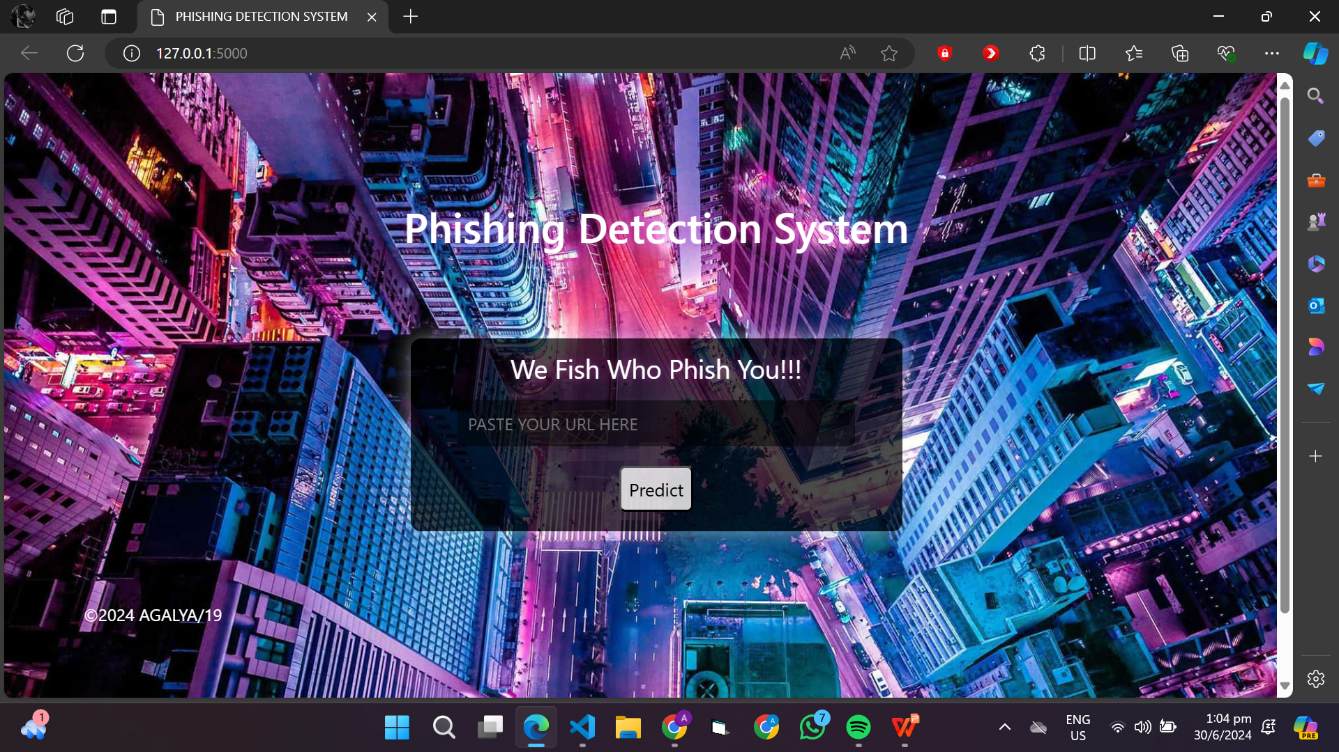
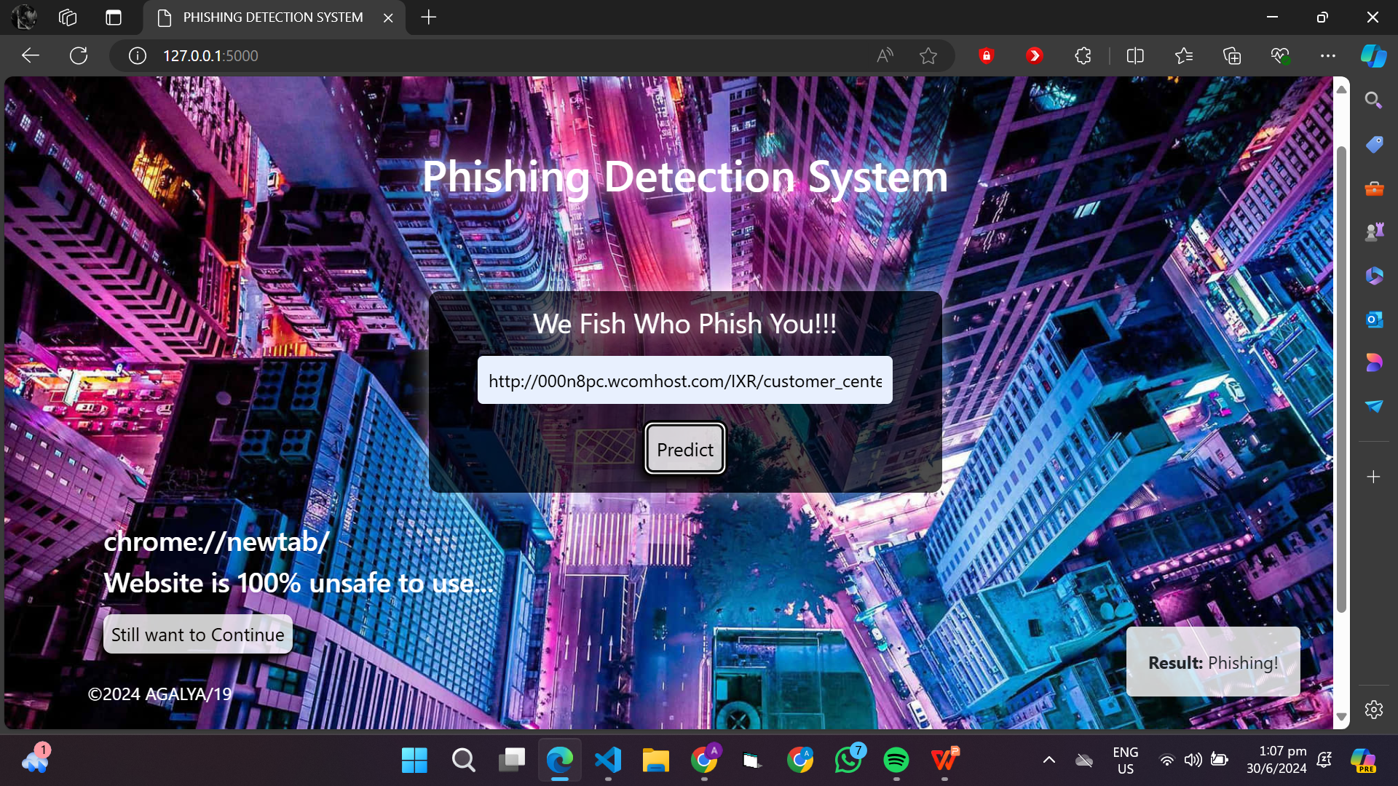
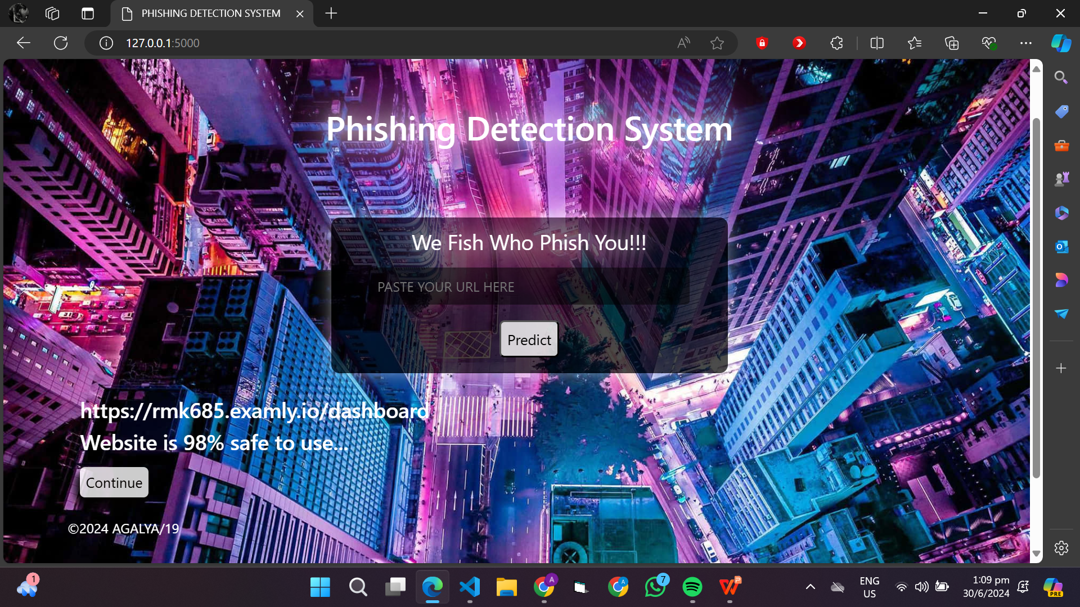
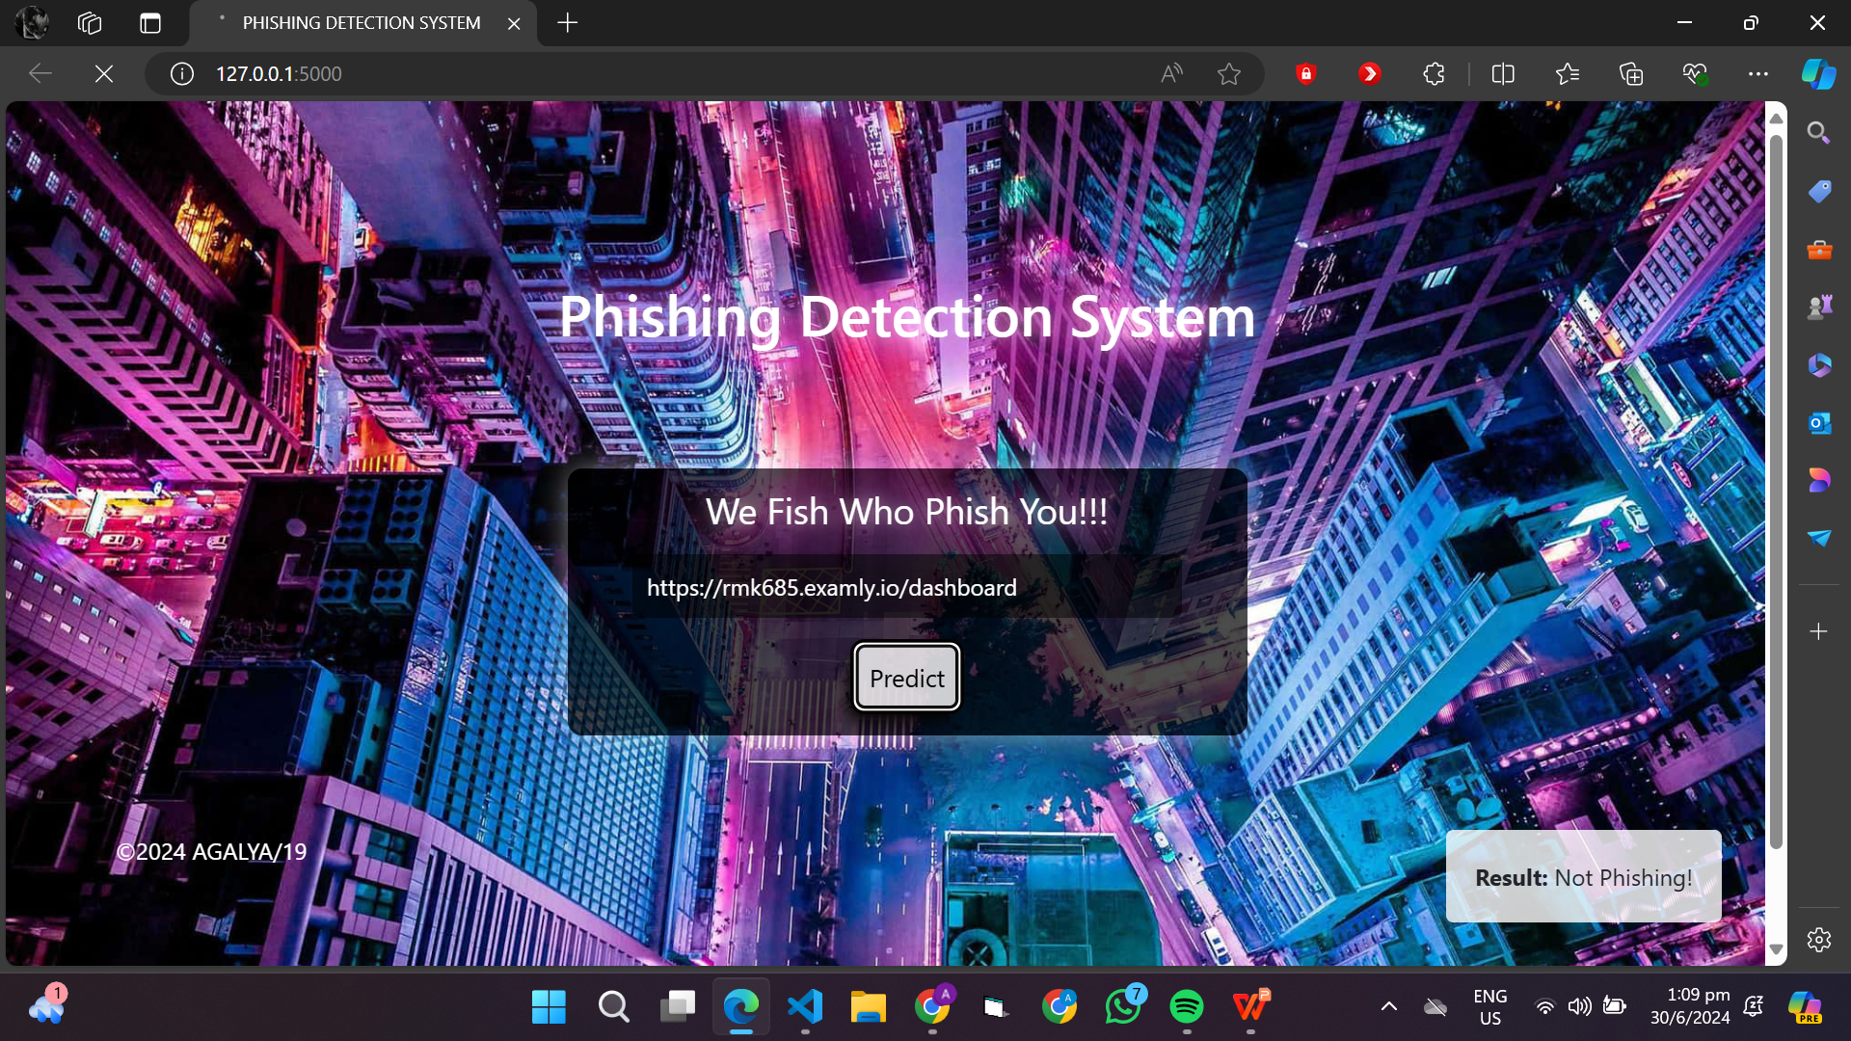

Slide 14
Project Link(GitHub, Google drive link)
https://github.com/Agalya1909/Edunet-Foundation.git

Slide 15
Conclusion
Achieved 97.4% accuracy using Gradient Boosting Classifier for phishing URL detection, surpassing traditional methods.
High precision and recall rates ensure effective identification of phishing URLs while minimizing false positives.
Key features such as "HTTPS", "AnchorURL", and "WebsiteTraffic" significantly influence the classification of URLs.
Enhanced understanding of phishing detection methodologies through exploration of various machine learning models.
Demonstrated the potential of machine learning in cybersecurity to mitigate online threats effectively.
Implement strategies to enhance the scalability and efficiency of the detection system, ensuring it can handle large-scale datasets and perform real-time analysis without compromising accuracy or speed.

Slide 16
Future scope
Enhanced Feature Engineering: Explore more advanced features such as behavioral analytics and deep learning-based representations for URLs to improve detection accuracy.
Real-Time Detection: Implement real-time monitoring and detection capabilities to swiftly respond to emerging phishing threats.
Integration with Threat Intelligence: Integrate with external threat intelligence sources to enhance model robustness against evolving phishing tactics.
User Behavior Analysis: Incorporate user behavior analytics to detect anomalies and phishing attempts based on interaction patterns.
Automation and Scalability: Develop automated systems for continuous model retraining and scalability to handle large volumes of URL data efficiently.
Multilingual and Global Adaptation: Extend detection capabilities to support multiple languages and adapt models to regional phishing trends worldwide.

Slide 17
References
Li, X., et al. "A deep learning approach for detecting phishing URLs." Computers & Security, vol. 88, 2020, 101636. doi:10.1016/j.cose.2019.101636.
Jagatic, T.N., et al. "Social phishing." Communications of the ACM, vol. 50, no. 10, 2007, pp. 94-100. doi:10.1145/1290958.1290968.
OpenPhish. Available online: https://www.openphish.com.
PhishTank. Available online: https://www.phishtank.com.
Python Software Foundation. Python Language Reference, version 3.9. Available online: https://www.python.org.
Scikit-learn: Machine Learning in Python. Pedregosa, F., et al. Journal of Machine Learning Research, vol. 12, 2011, pp. 2825-2830. Available online: https://scikit-learn.org.

Slide 18
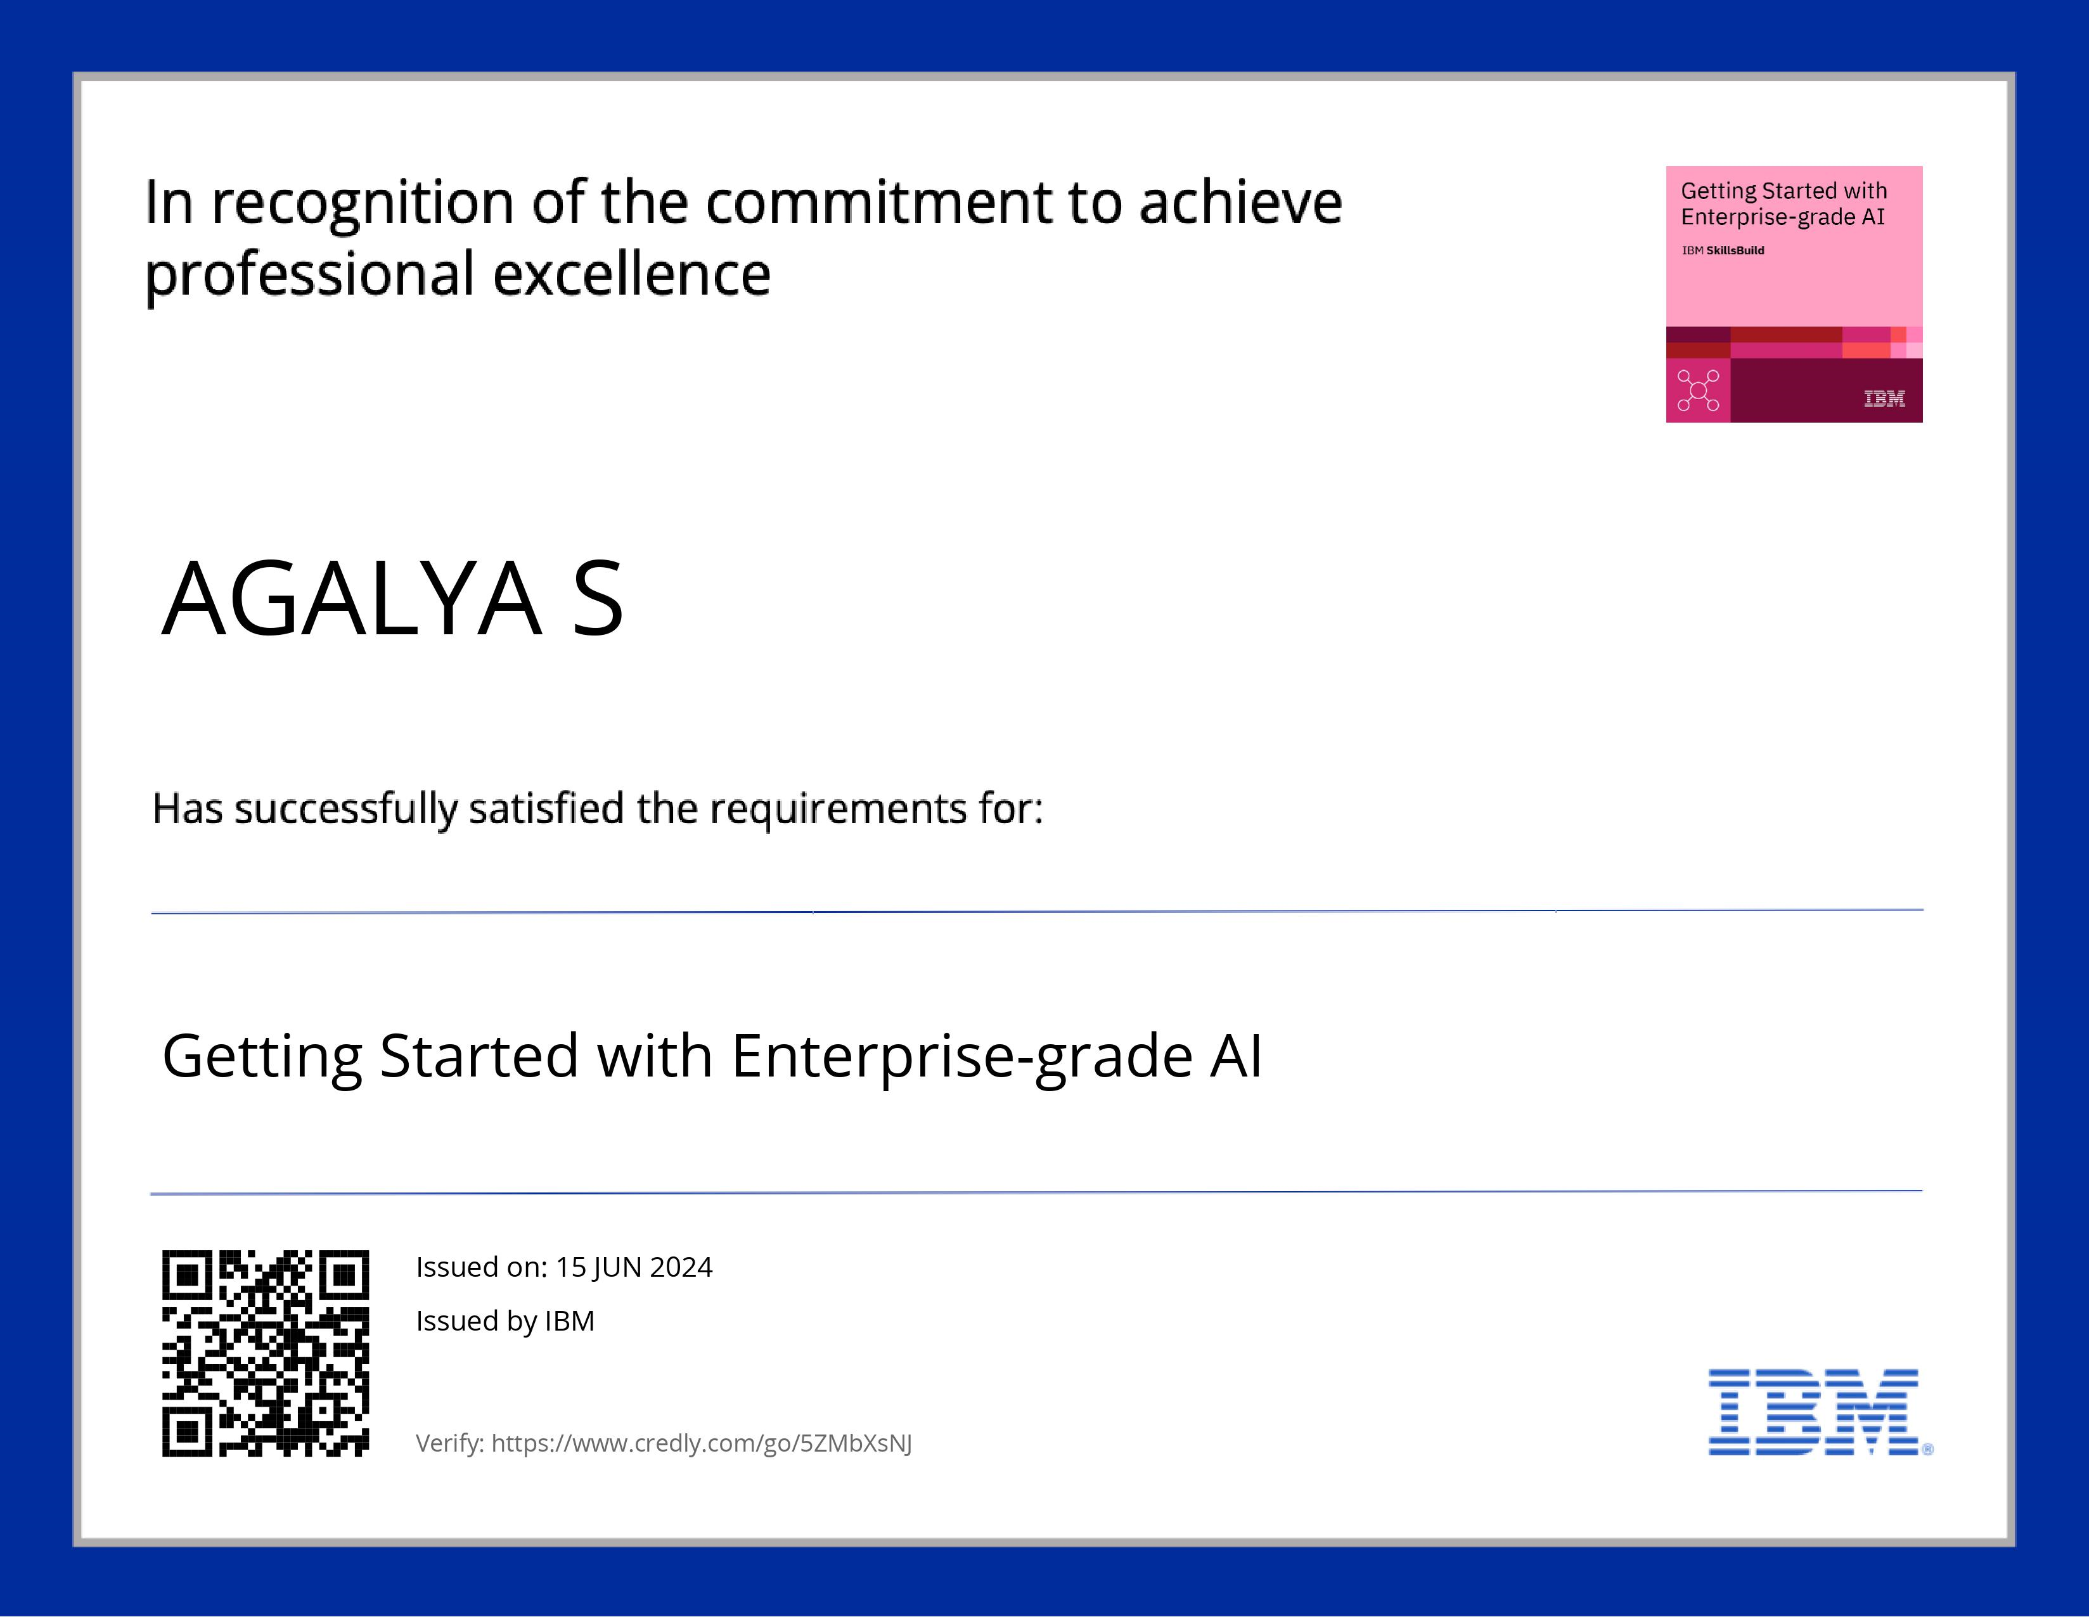
course certificate 1

Slide 19

course certificate 2

Slide 20
THANK YOU

